Slide 1


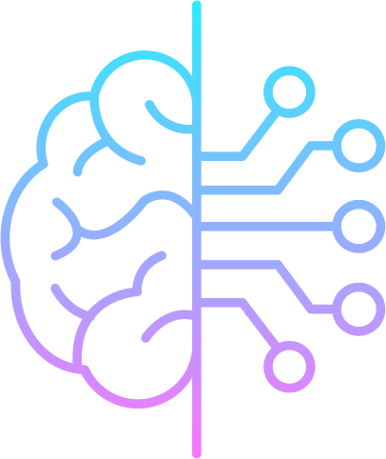
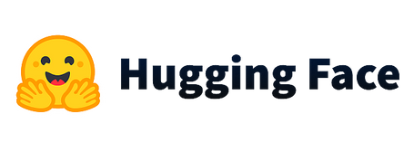



workshop #02
Artificial intelligence and data science

Slide 2
In the previous workshop, we got acquainted with many concepts,
and how to use them, such as:
Variables and their types, what are operators and their uses.
Indentation in Python and its role in defining program structure and controlling program flow.
Then we moved on to the "if" conditional statement.
And then to loops like “for” and “while.”
At the end of the workshop we took the concept of functions

Slide 3
1-Variables:
Variables are containers used to store values.
In Python, variables are declared simply by assigning a value to them.
Different data types such as integers, float, strings, etc. can be stored in variables.
Examples:
x = 5 # integer
name = "John" # string
price = 19.99 # float number

Slide 4
2-Operators:
Operators are symbols that perform operations on variables.
In Python, there are several types of operators such as arithmetic, comparison, assignment, and logical operators.
Examples:
Arithmetic: +, -, *, /, %, **
sum = 5 + 10
result = 15 / 5
Comparison: ==, !=, <, >, <=, >=
is_equal = 5 == 10
is_greater = 5 > 10
Assignment: =, +=, -=, *=,
x = 5
x += 10
Logical: and, or, not
is_true = (5 > 2) and (10 < 15)
is_false = not (5 > 10)

Slide 5
3-Indentation:
Indentation is the practice of using whitespace to indicate the structure of a program.
In Python, indentation is used to define the block of code associated with control structures such as if statements, loops, and functions.
Example:
if x > 10:
print("x is greater than 10")
else:
print("x is not greater than 10")

Slide 6
4-Conditional Statements:
Conditional statements are used to make decisions in a program based on certain conditions.
In Python, the if-else statement is used to perform conditional operations.
Example:
if x > 10:
print("x is greater than 10")
else:
print("x is not greater than 10")

Slide 7
5-Loops:
Loops are used to repeat a block of code multiple times.
In Python, there are two types of loops: for loops and while loops.
Examples:
For Loop:
for i in range(5):
print(i)
While Loop:
i = 0
while i < 5:
print(i)
i += 1

Slide 8
6-Functions:
Functions are blocks of code that perform a specific task.
In Python, functions are defined using the def keyword.
Functions can take arguments and return values.
Example:
def sum(x, y):
return x + y
--------------------------
result = sum(5, 10)
print(result)

Slide 9
Scripts, Functions, Modules and Libraries
Python provides a variety of structures to help programmers write, organize, and reuse code effectively.
One of these tools is scripts, which are collections of code written in Python and executed line by line. Functions are another structure, which are blocks of code that can be called and reused. Modules are collections of functions and other objects in Python, and libraries are collections of modules that provide pre-written code for common tasks.
In next slides, we will discuss each of these concepts in detail.

Slide 10
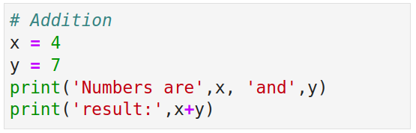
Scripts
A script in Python is a basic and small unit of code and executed line by line. It is typically used to perform one-time operations, or test small pieces of code.

Slide 11
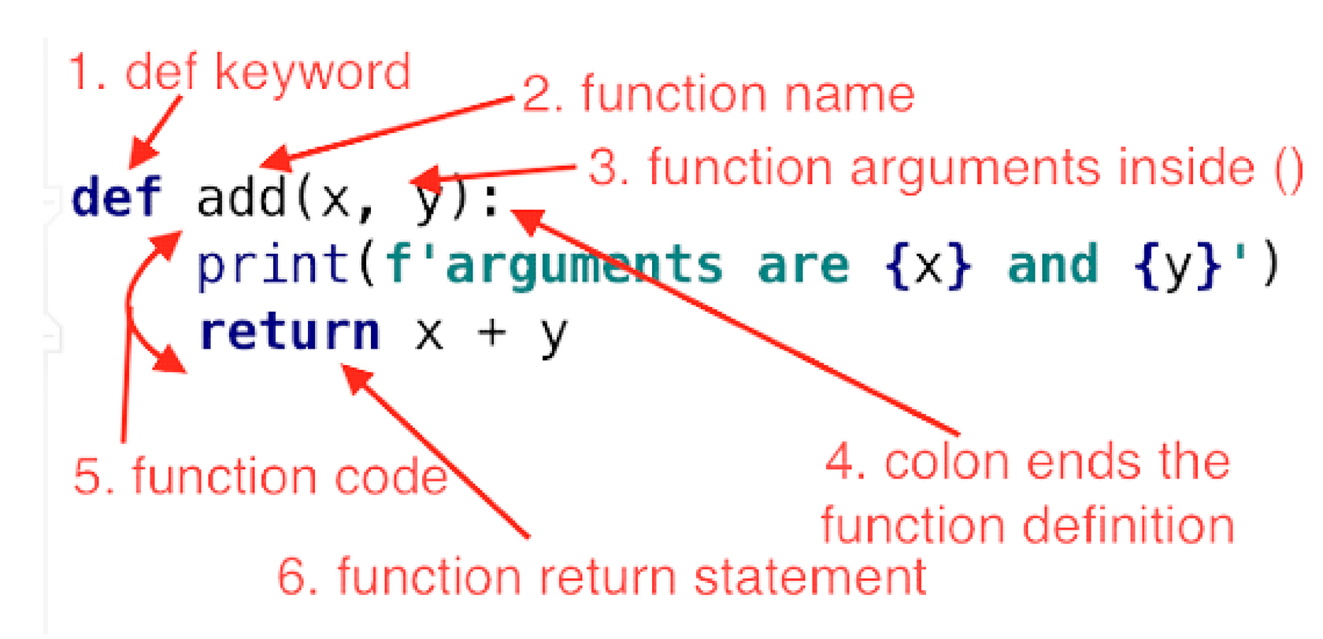
Functions
Functions are a way to organize code into reusable blocks and allow us to call it when we need to.
Functions can be passed inputs, called arguments, and can return output.

Slide 12
Modules
Even though the script is converted to a function, we still have to rewrite the function when we need it in another program.
For this we will get to know the module,
A module is a file containing Python definitions and statements. Modules can define functions, classes, variables, and any other objects in Python.
A module can be imported into another Python script or program, making its functions, classes, and objects available for use.
To make the idea clearer, let's take an example.
Let's collect the functions of performing arithmetic operations in a module.

Slide 13
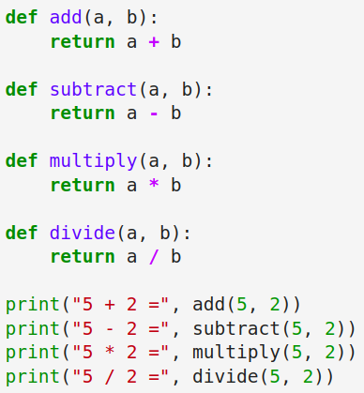
Modules
To convert this script into a module, we can save it in a separate file with a .py extension, for example, arithmetic.py.
Here is an example of a simple Python script that implements functions for arithmetic operations:

Slide 14
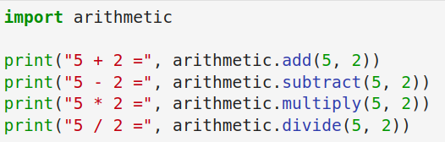
Modules
Then, in another script or program, we can import this module and use its functions.

Slide 15
Libraries
A library is a collection of modules that provide additional functionality for use in a Python program.

Slide 16
Libraries
Well-known libraries for data manipulation
Pandas
NumPy
Pandas is a library for data analysis that provides fast and flexible data structures for efficiently storing and manipulating large datasets.
NumPy is a library for numerical computing that provides support for large arrays and matrices of numerical data, along with a large collection of mathematical functions to operate on these arrays.
pip install pandas
pip install numpy

Slide 17

what is artificial intelligence
Artificial intellligent is simply humen intelligence exubited by machines .Now days artificail intelligent is in all life domains because it make our lifes easier and save as time and money .

Slide 18
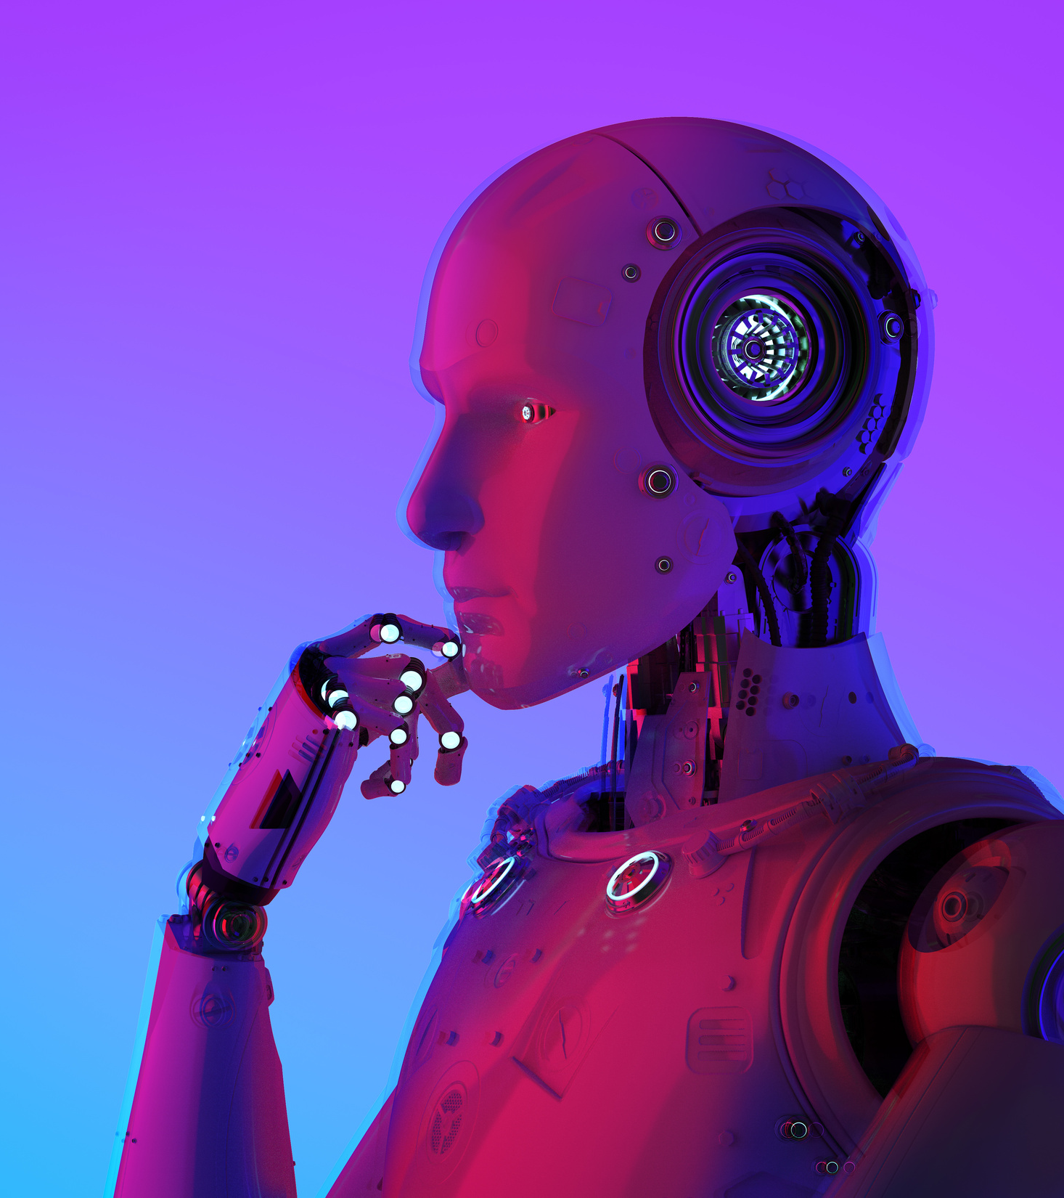
what is
artificial intellegence
is apopular branch of computer science that concerns with building intellignt systems.

Slide 19
ai applications
AI has a wide range of applications, from healthcare to finance. AI can be used to automate tasks, improve accuracy and efficiency, and reduce costs. AI is also being used to develop new products and services, as well as to improve existing ones. AI can also be used to analyze data and make decisions based on that data.

Slide 20
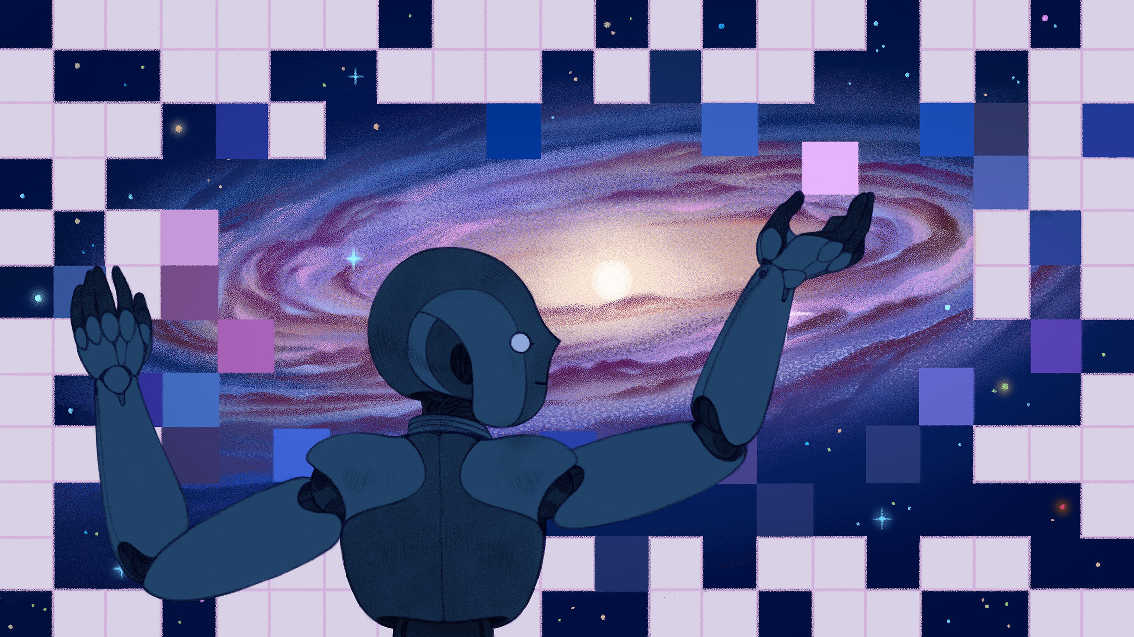
how ai is changing science
The latest AI algorithms are probing the evolution of galaxies, calculating quantum wave functions, discovering new chemical compounds and more.
Votre texte de paragraphe

Slide 21
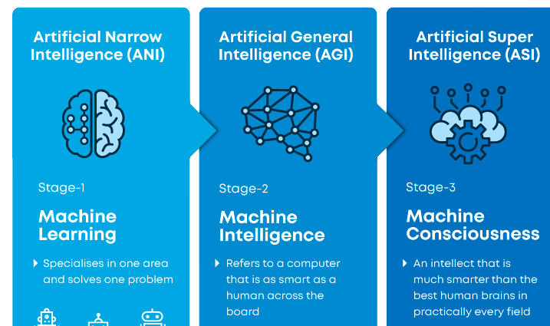
levels of artificial intellignece

Slide 22



ARTIFICAIL INTELLEGENCE SUBSETS
ARTIFICIAL INTELLIGENCE
MACHINE LEARNING
DEEP LEARNING
ENGINEERING OF MAKING INTELLENGT MACHINE AND PROGRAMS
ability to learn without bieng explicitly programmed
learning based on neural network

Slide 23
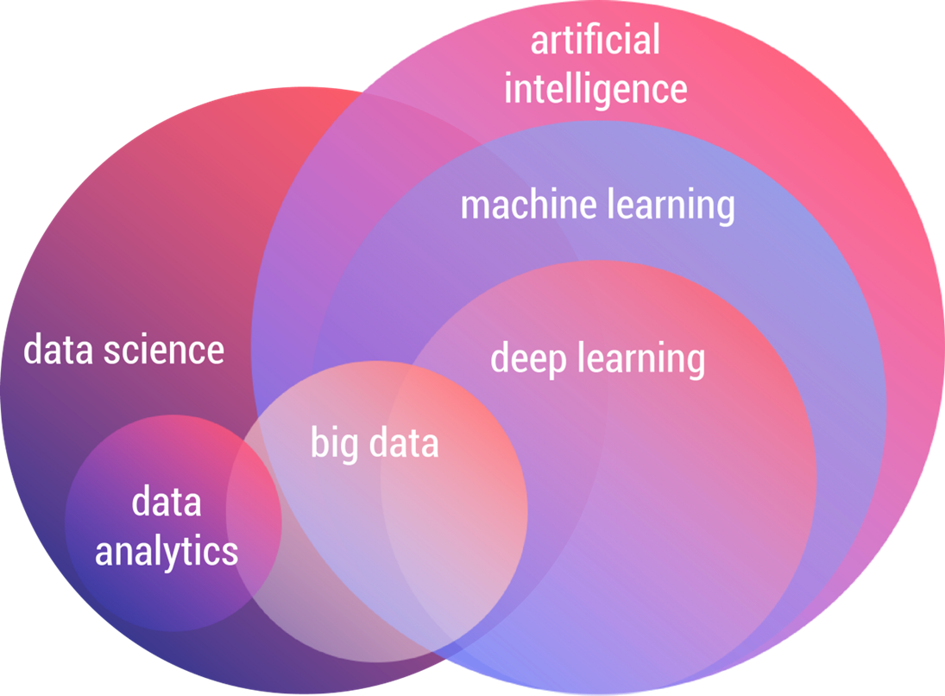
the relation between data sceince and ai

Slide 24
machine learning
"Machine learning is a subfield of artificial intellignce based on the idea that systems can learn from data, identify patterns and make decisions with minimal human intervention.

Slide 25
machine learning
Traditional
program
input
Machine
learning
input
output
model
output
(Program)
data

Slide 26
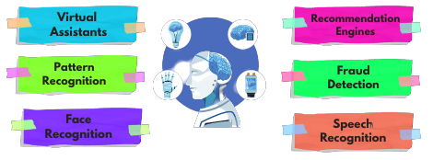
appllication of machine learning

Slide 27
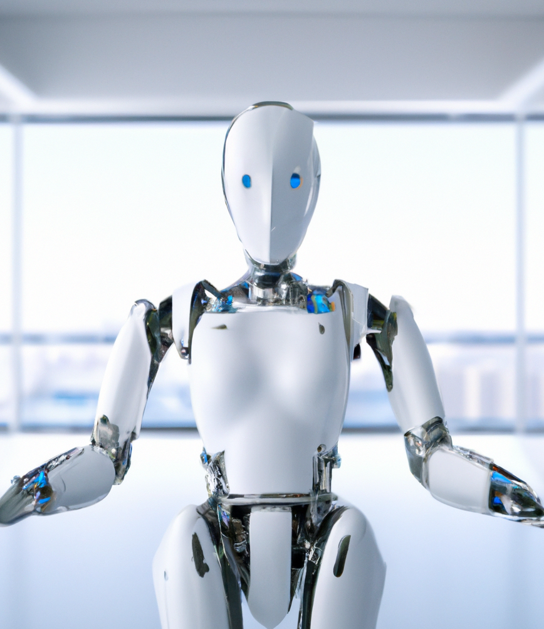
appllication of machine learning
predict costumer behaivuors
diagnose midical conditions
optimize business operations

Slide 28

step to implement machine learning

Slide 29

1 define objectives
identify the problem to be solved and create a clear objectives.

Slide 30
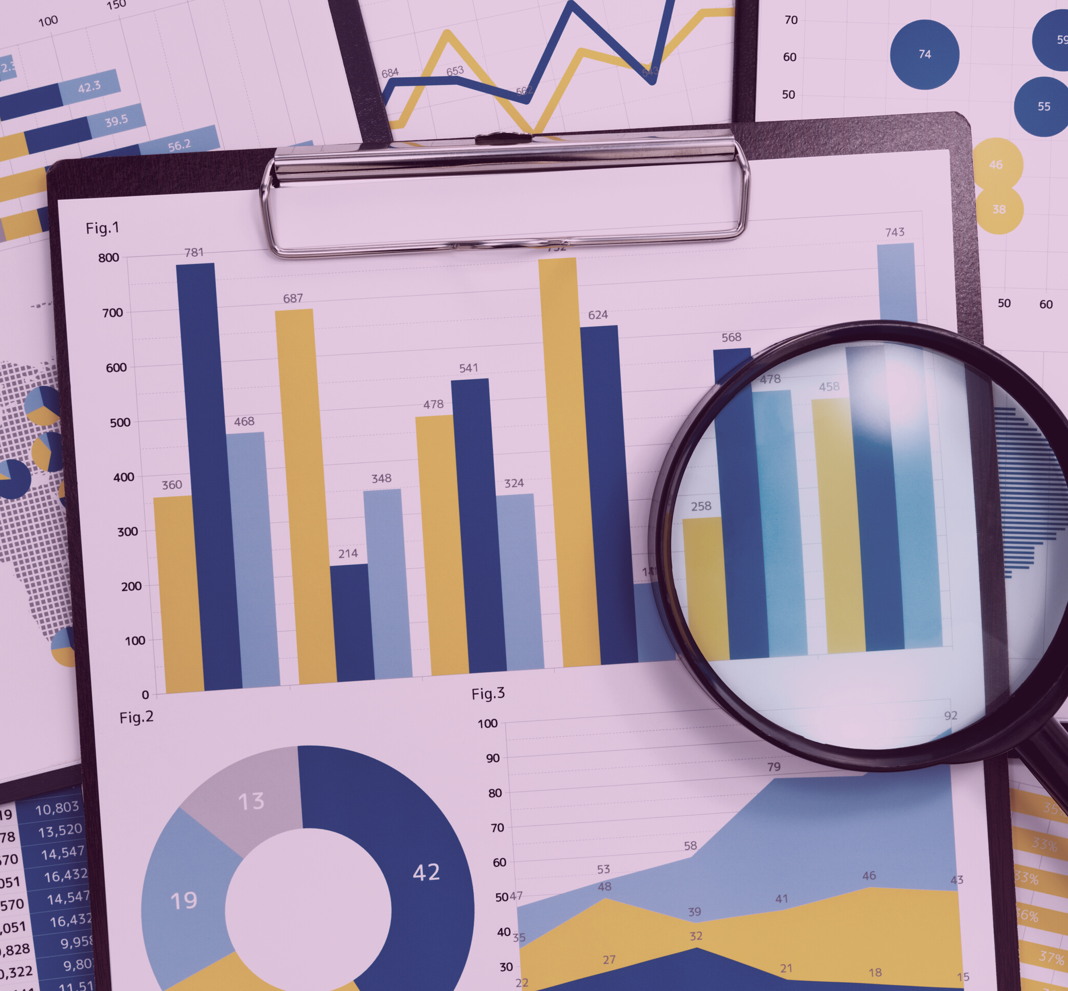


2 collect data
Collect data using sensors or download it from famous data bases like Kaggle, UCI, Physionet
or hospitals and social service agencies.

Slide 31
3 data pre-processing
A real-world data generally contains noises, missing values, and maybe in an unusable format which cannot be directly used for machine learning models. Data preprocessing is required tasks for cleaning the data and making it suitable for a machine learning model which also increases the accuracy and efficiency of a machine learning model.

Slide 32
pre-processing steps
data formatting
DATA CLEANING
data sampling
the organization of information according to preset specifications

Slide 33
Well-known libraries for data visualization
Matplotlib
Seaborn
Matplotlib is a 2D plotting library for Python. It allows for creation of a wide range of static, animated, and interactive visualizations in Python. It provides a high-level interface for drawing attractive and informative statistical graphics.
Seaborn, is a data visualization library based on matplotlib. It provides a high-level interface for creating statistical graphics and is particularly well suited for representing statistical models. Seaborn extends matplotlib and adds additional plot types, including heatmaps, violin plots, and box plots, as well as functions for styling and customizing plots.
pip3 install matplotlib
pip3 install seaborn

